Slide 1

Marketing at Back Thru The Future

Slide 2
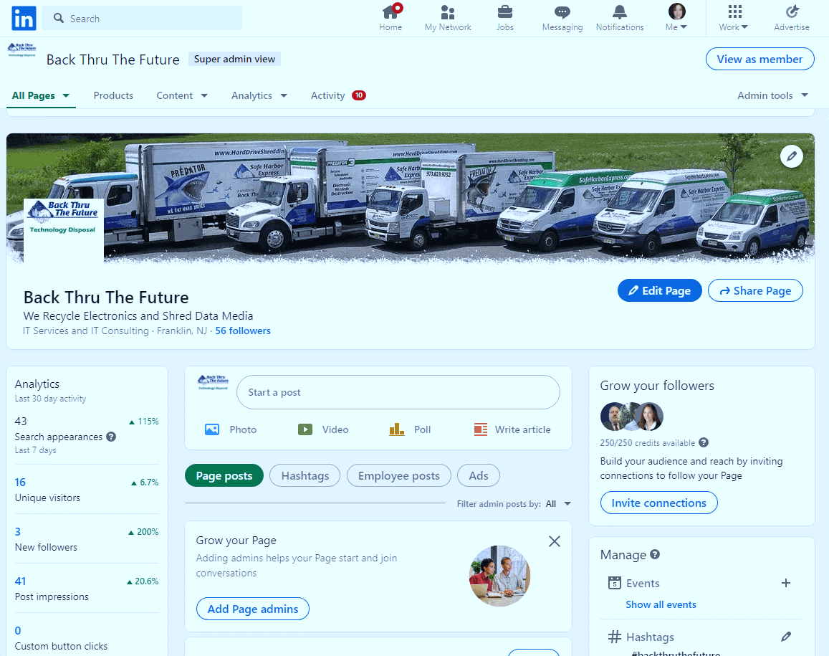
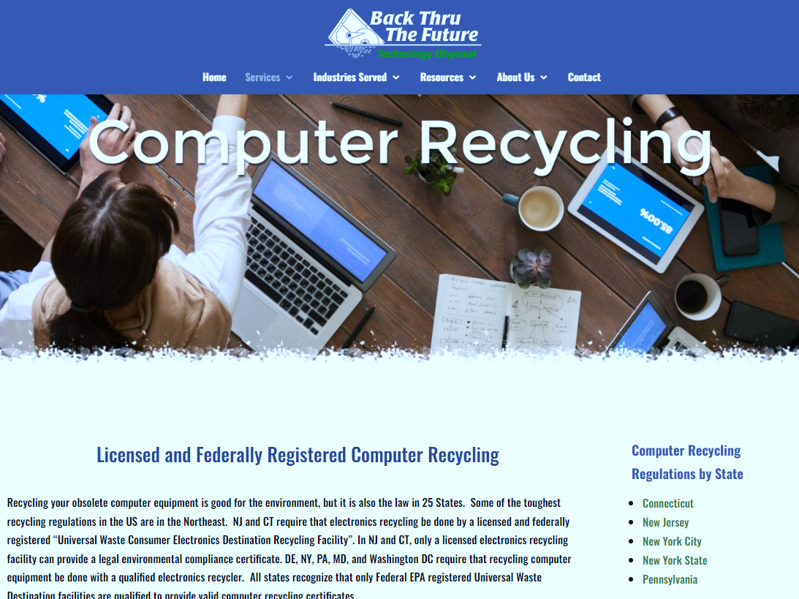
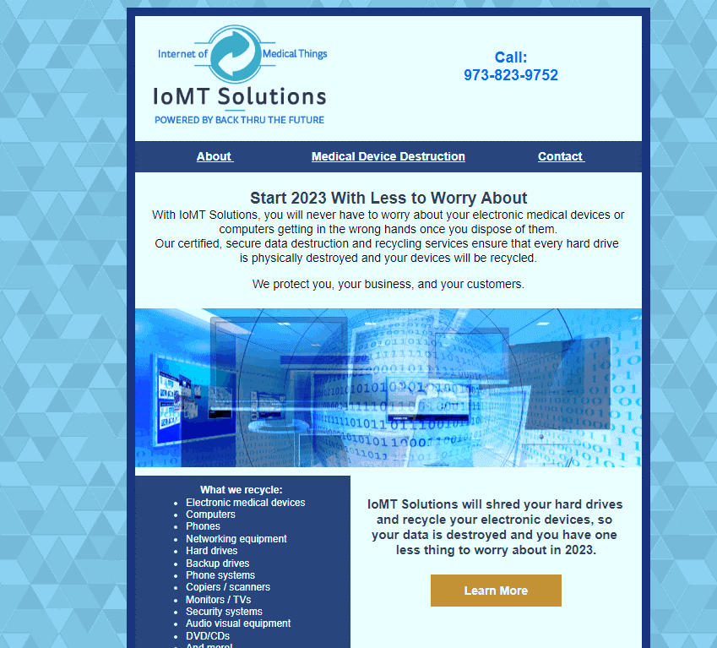
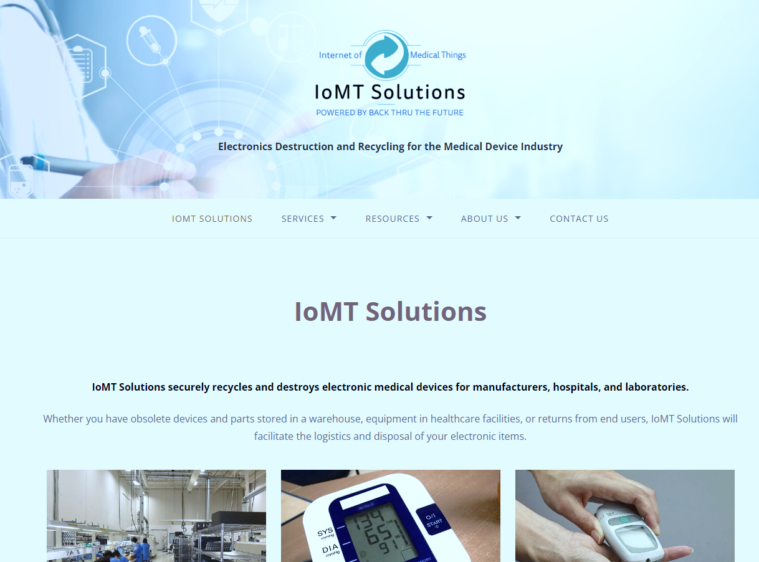
What does Marketing do?
Websites
SEO
Social Media
Email Marketing
Marketing Material
Publicity
Sales Support
Brand Recognition

Slide 3
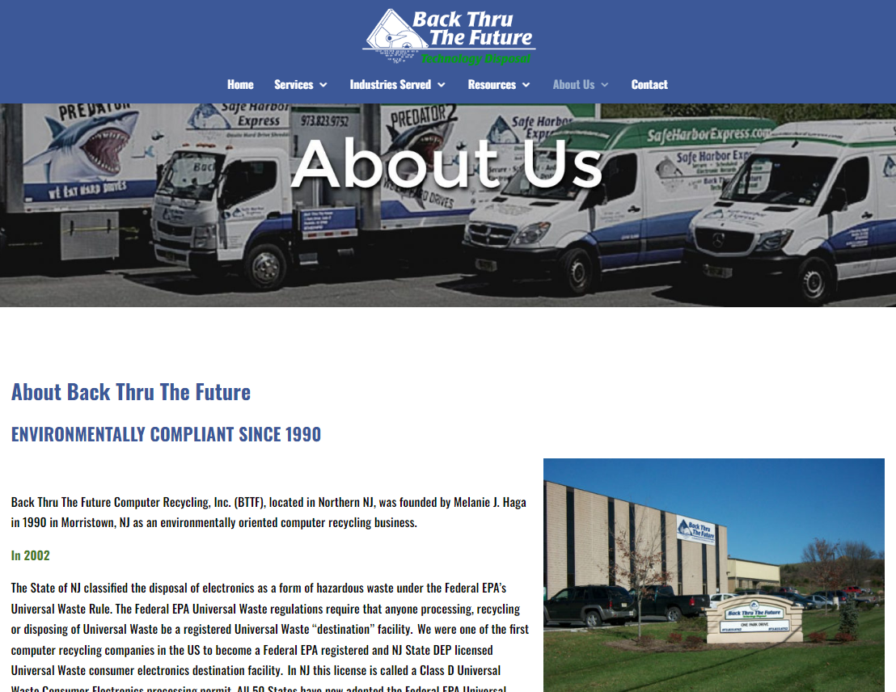
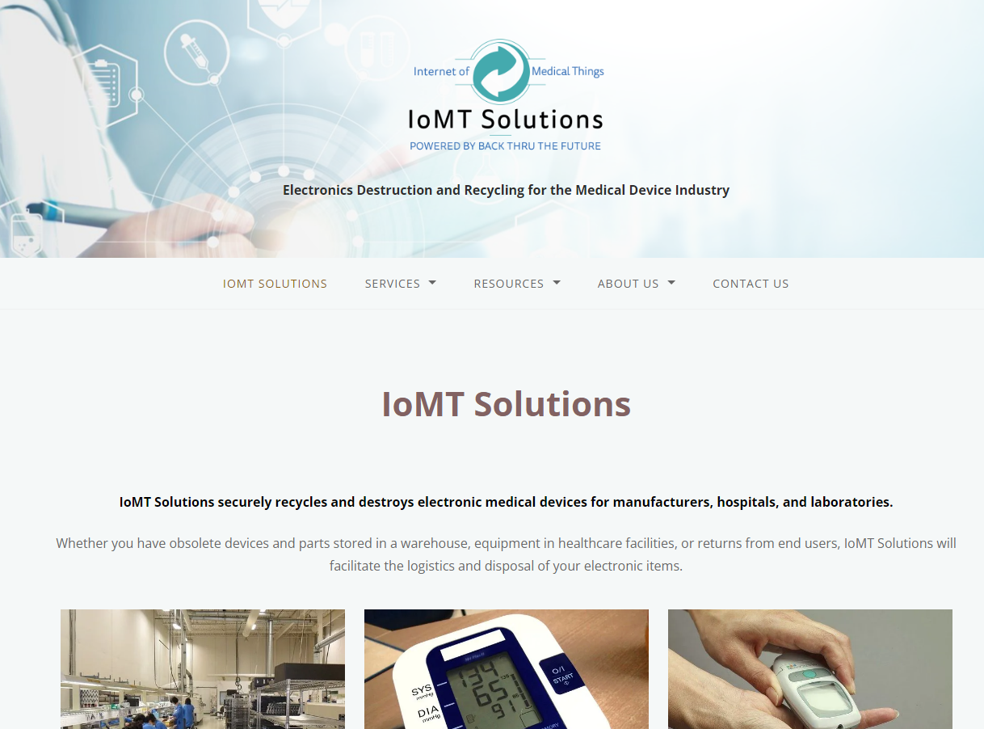
Websites
www.backthruthefuture.com
www.IoMTSolutions.com
For legal, retail, financial, and healthcare industries
For medical device manufacturers
Add new content and blog posts to maintain relevance
Update pages to reflect new trends
Create landing pages for special promotions
Look for link opportunities
Search Engine Optimization (SEO)

Slide 4
Search Engine Optimization (SEO)
When someone searches for computer recycling, what do they see?
SEO helps to make sure that people find us when they search. There are a lot of ways to do that, including:
New content (blog posts)
Key search words throughout the website (What key words are people searching?)
Links to and from reputable websites
Easy-to-read language (short sentences, active voice, grammatically correct)
It’s Marketing’s job to know what people are searching to find us, AND our competition.

Slide 5
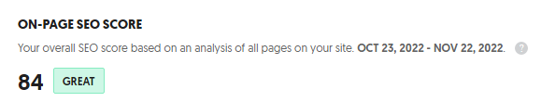
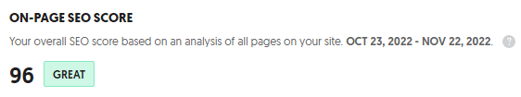
What is our SEO Score?
An SEO score measures how healthy your website is. A higher score will predict where you will appear on a google search.
For both websites, our score is GREAT.

Slide 6
Social Media
The key to a good social media is knowing:
Who is our ideal client?
What social media are they on?
We want BIG accounts with a lot of equipment that gets refreshed frequently.
We DON’T want to make frequent stops to pick up one or two things. That’s not an effective way to make a profit.
So where would IT managers, project managers, inventory specialists, and supply chain managers be?
Linkedin. It’s for business, networking, and industry information. That’s where we are.

Slide 7
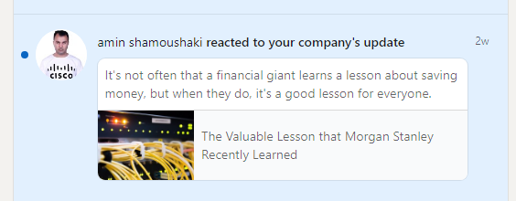
We keep our Linkedin content fresh with bi-weekly posts and original articles.
Why don’t we want lots of small businesses?
We need to weigh the effort against the payoff. Picking up 3 hard drives is the same amount of paperwork, gas, time, and effort to collect payment as 3000 hard drives.

Slide 8
Effort vs. Payoff
Driver 1
Driver 2
Stop #1: Picks up 40 hard drives, 16 laptops, 4 printers, and 19 desktops. Client wants us to come back next month for their data center.
He drives back, finishes paperwork for the job.
Job is processed and 1 invoice is created. Certificate of destruction and recycling is uploaded to Compliance Library and customer is billed.
Stop #1: Picks up 3 hard drives, 2 laptops.
Stop #2: Picks up 2 hard drives, 1 printer, 3 desktops.
Stop #3: Picks up 4 cell phones, 1 printer, 2 laptops
Stop #4: Picks up 6 desk phones, 2 desktops
He drives back, finishes paperwork for job 1, job 2, job 3, and job 4.
Jobs 1-4 are processed, and 4 invoices are created. Certificates of destruction and recycling are uploaded to Compliance Library for 4 clients.
Total collected: 40 hard drives, 16 laptops, 4 printers, and 19 desktops.
Total collected: 5 hard drives, 4 laptops, 2 printers, 5 desktops, 4 cell phones, 6 desk phones

Slide 9
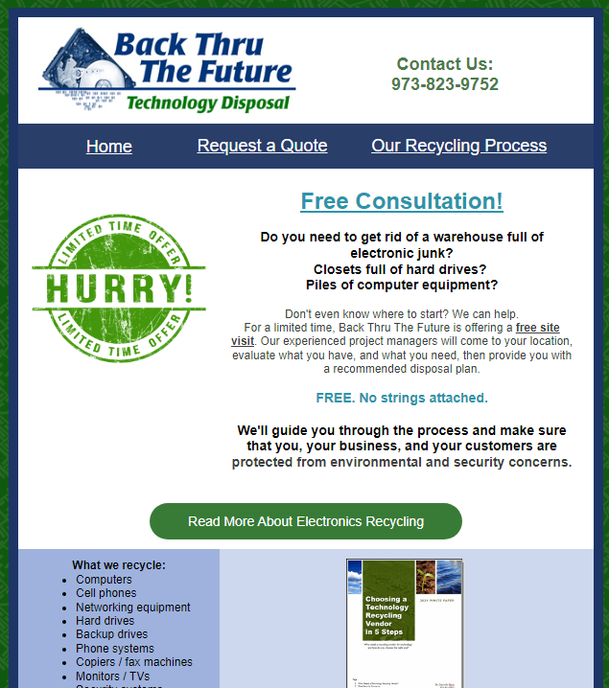

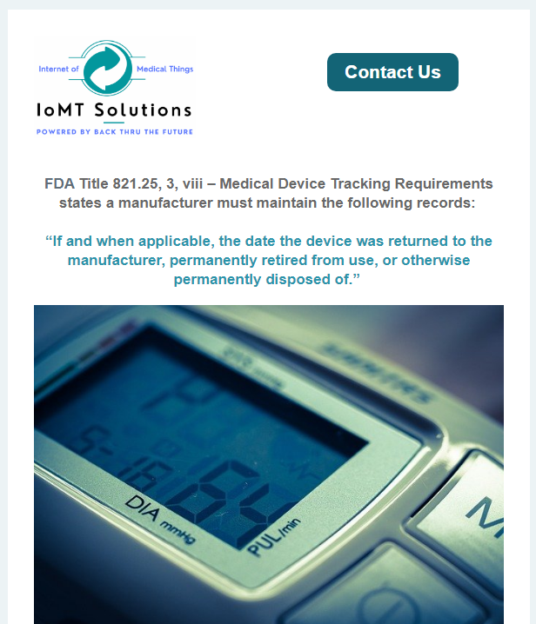
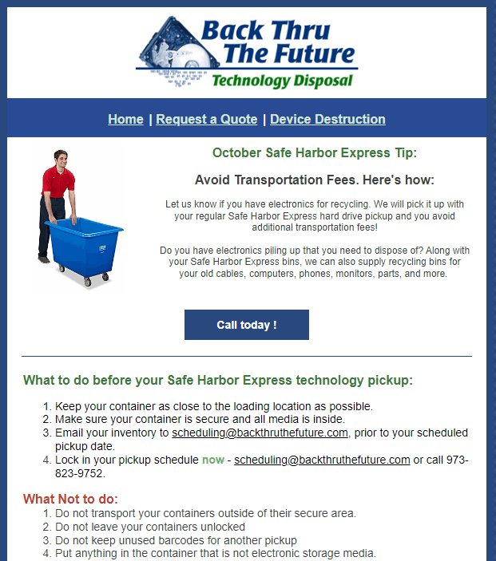
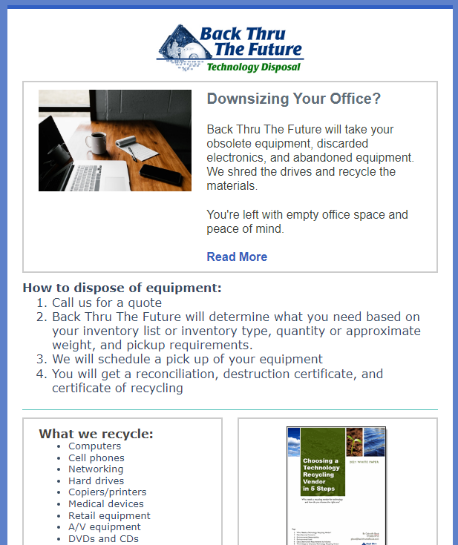
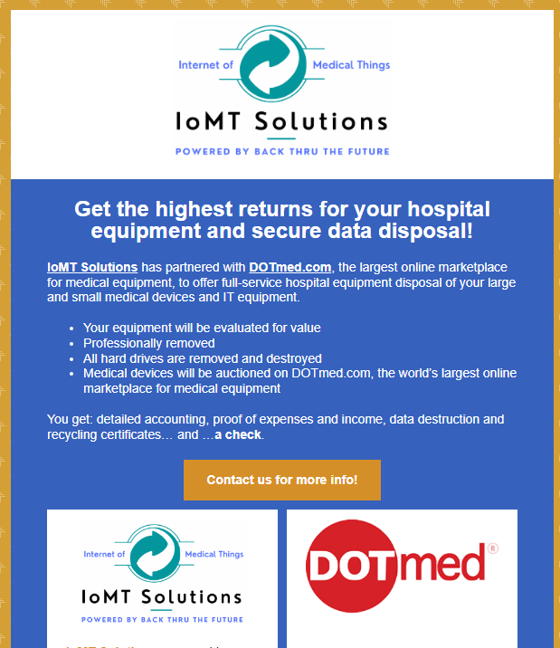
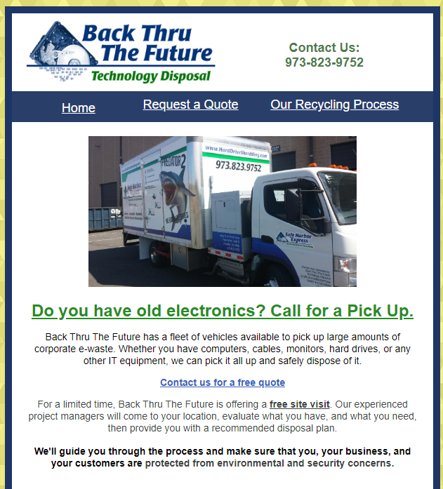
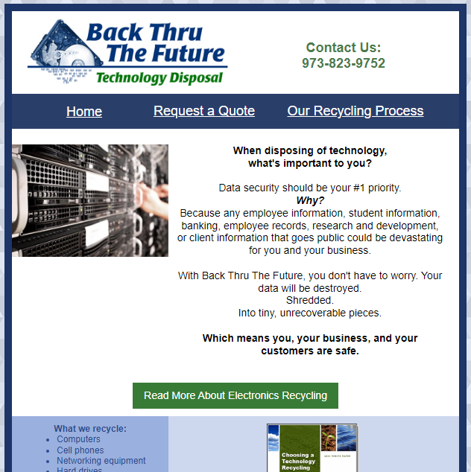
Email marketing
Every month, we send:
Promotional emails to Back Thru The Future clients and prospects
A Tip of the Month email to our SHE customers
Promotional emails to IoMT Solutions contacts (medical device manufacturers)
Notes:
(These don’t have designer IDs since they were based off the default master slides already in the deck.

Slide 10
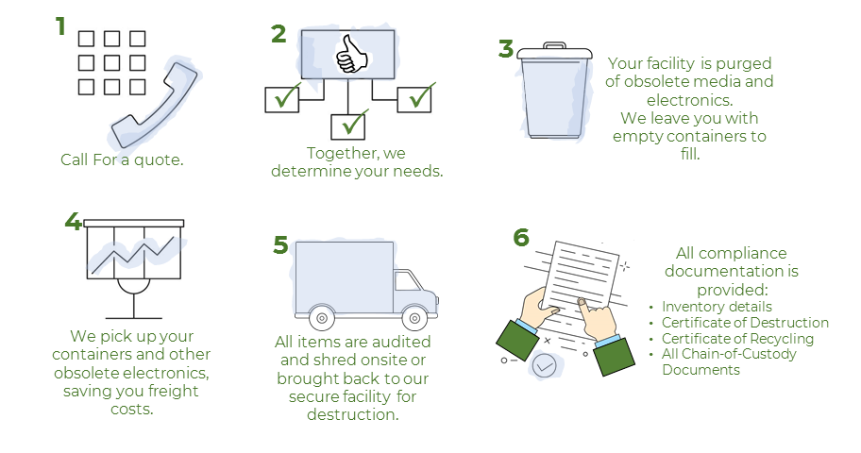
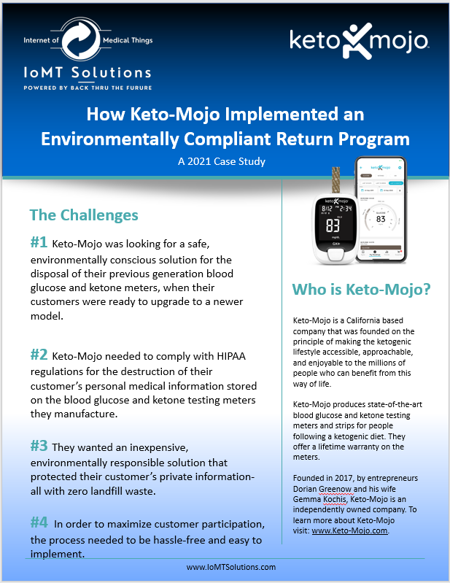



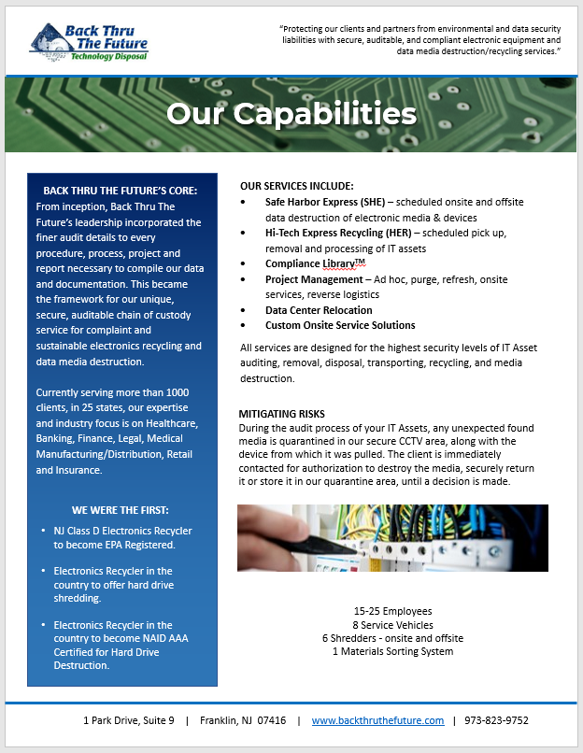
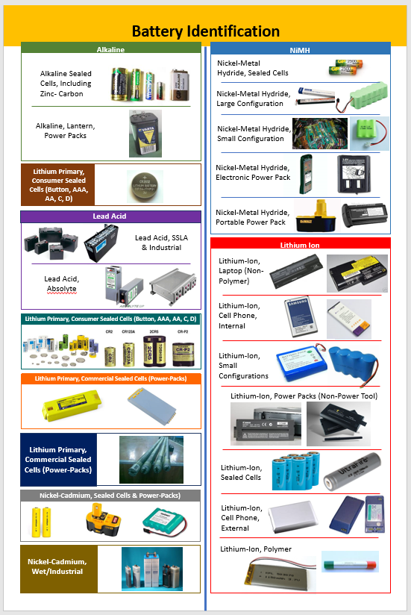
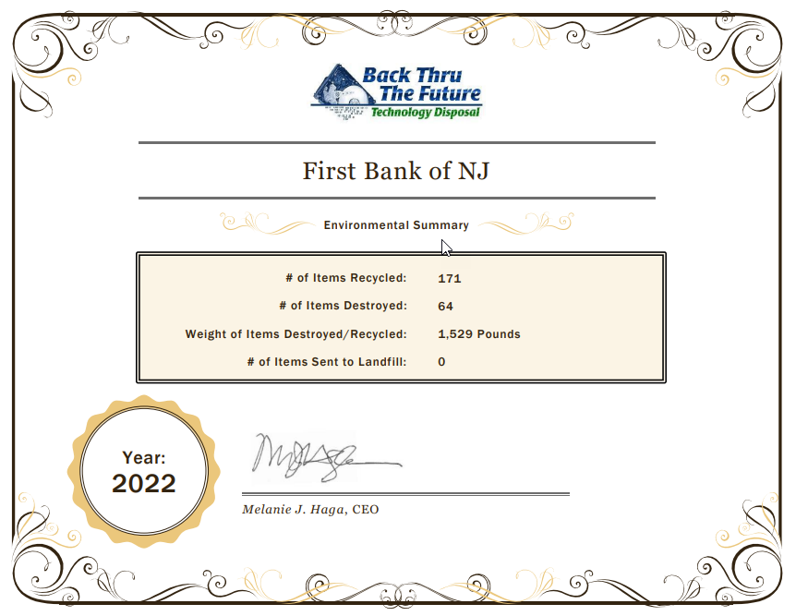

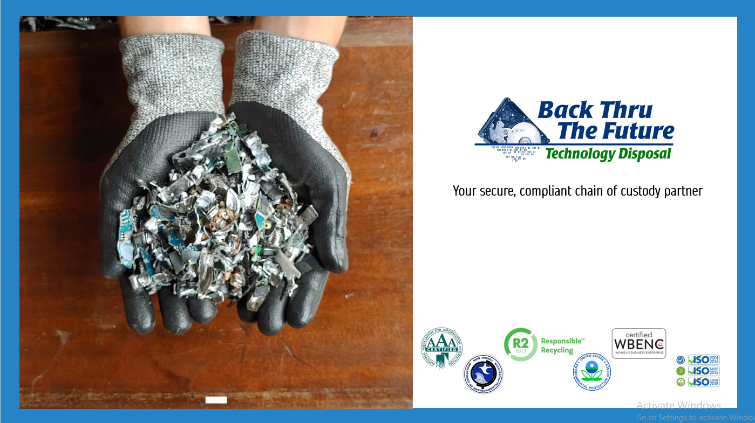

Marketing Material
PDFs
Brochures
Presentations
Case studies
Graphic Design

Slide 11

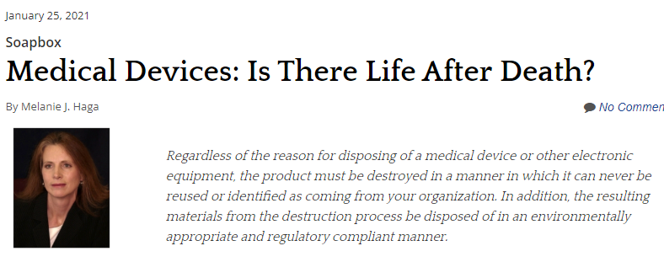
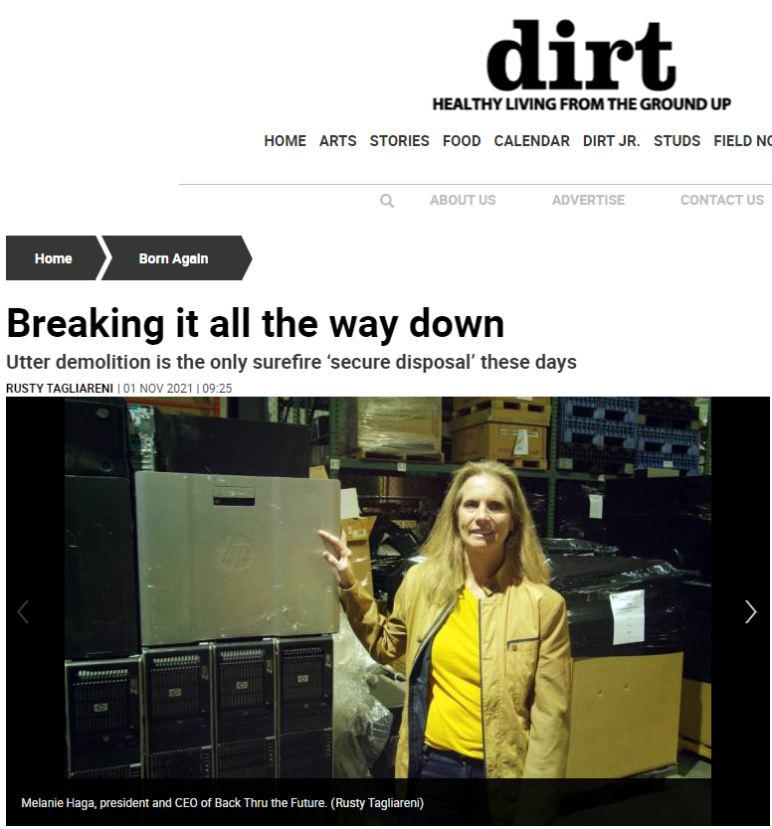
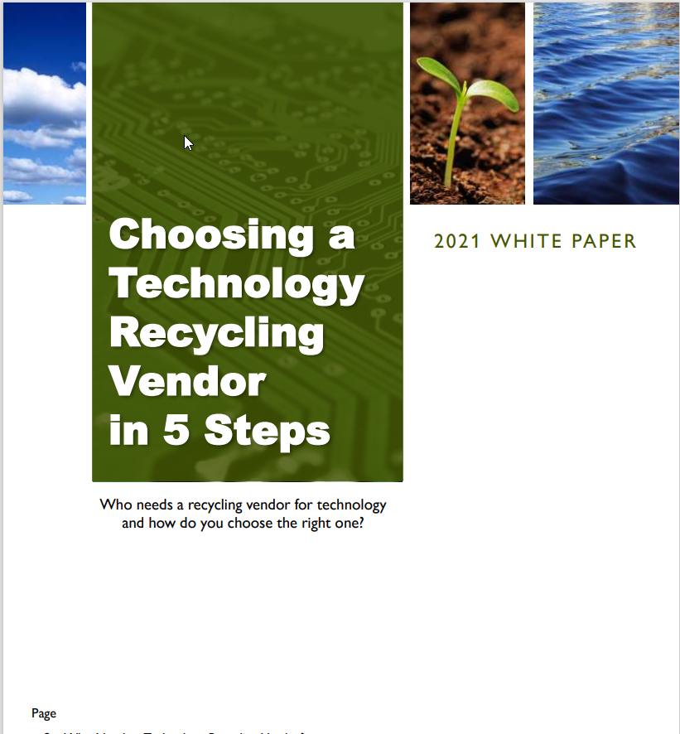
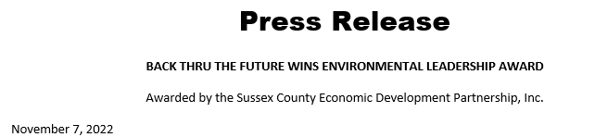
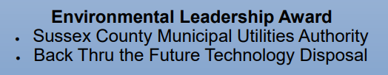
Publicity
Published articles by us
Published articles about us
White papers
Press releases
Awards

Slide 12
Sales Support and Brand Recognition
Marketing supports sales opportunities in big and small ways, including these:
Generating leads
Support material for meetings
Industry research
Competitive analysis
Sales reports
Copywriting
What’s Brand Recognition?
It’s making sure our logos looks the same, we are wearing branded clothes in the right colors, and that we talk about our services the same way, everywhere.

